Slide 1
Exploring Open-Source ML Libraries

Slide 2
Introduction
This chapter explores popular open-source machine learning (ML) libraries.
We will cover core libraries used in data processing, model training, and evaluation.
Focus will be on scikit-learn, Apache Spark ML, TensorFlow, and PyTorch.
These libraries are integral to building scalable and effective ML solutions.

Slide 3
Core Features of Open-Source ML Libraries
ML libraries provide essential tools for data manipulation, model building, and evaluation.
Core functionalities include data processing, model training, evaluation, saving, and model serving.
Support for multiple programming languages, including Python, Java, and Scala, makes them versatile.
Python is the most widely supported language across major ML libraries.
Libraries like scikit-learn provide comprehensive support for building pipelines to automate data processing and model training.

Slide 4
Understanding the scikit-learn ML Library
scikit-learn is one of the most popular open-source ML libraries for Python.
It offers a wide range of ML algorithms for classification, regression, and clustering tasks.
Built on top of foundational libraries like NumPy, SciPy, and Matplotlib.
Widely used for business applications, including customer segmentation, churn prediction, and recommendation systems.
scikit-learn supports easy integration with other Python libraries such as pandas and Matplotlib, making it efficient for end-to-end data analysis and visualization.
It provides a simple and consistent API for implementing complex machine learning algorithms with minimal code, making it accessible to both beginners and experts.

Slide 5
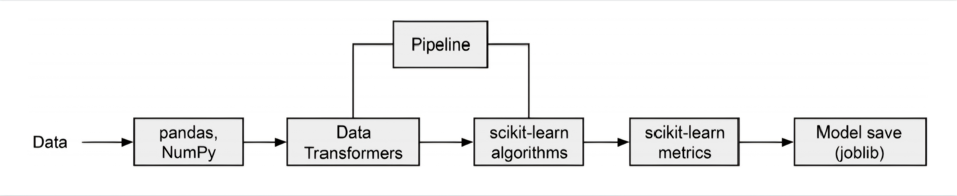
scikit-learn components

Slide 6
Core Components of scikit-learn
scikit-learn includes components for data preprocessing, model training, evaluation, and saving models.
Supports transformers for data manipulation, such as encoding categorical values and handling missing data.
Includes various ML algorithms for classification, regression, and clustering.
Pipeline utilities allow combining transformers and estimators into a single workflow.

Slide 7
Installing scikit-learn
scikit-learn can be easily installed using pip or Conda package managers.
Command for pip: `pip install -U scikit-learn`.
Command for Conda: `conda install scikit-learn`.
Installation makes it easy to integrate into Python-based environments.

Slide 8
Understanding Apache Spark ML Library
Apache Spark is a distributed data processing framework that handles large-scale data.
Spark MLlib supports distributed ML model training, making it suitable for large datasets.
Uses DataFrames for data manipulation and supports lazy execution for optimization.
Spark clusters consist of a driver and worker nodes that process data in parallel.
Apache Spark’s lazy execution model improves efficiency by optimizing transformations only when an action is required, reducing overhead.
Spark supports parallel processing across clusters, allowing for efficient handling of big data workloads with distributed ML algorithms.

Slide 9
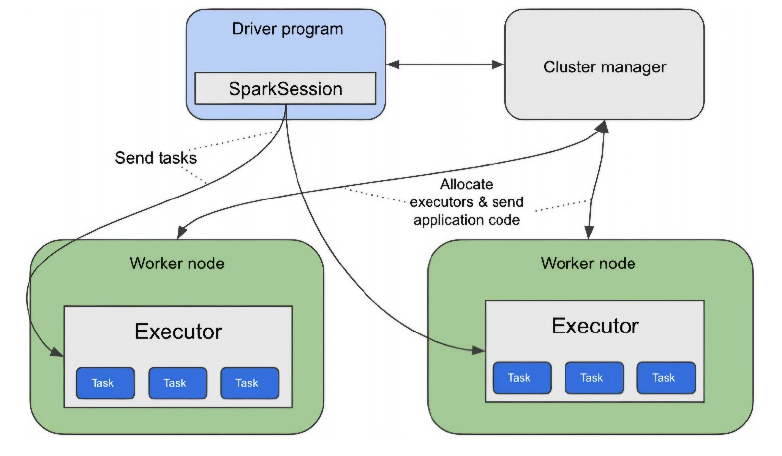
Running a Spark application on a Spark cluster

Slide 10
Installing Spark ML
PySpark is the Python API for Spark and can be installed using pip.
Command: `pip install pyspark`.
Requires Java and Python installed on the machine for successful installation.
Spark provides APIs in Python, Scala, Java, and R.

Slide 11
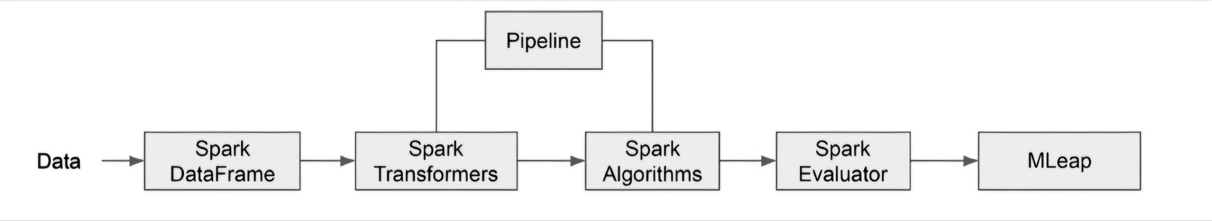
Core components of Spark ML

Slide 12
Core Components of Spark ML
Spark supports DataFrames for handling distributed data across a cluster.
Includes transformers for data processing, such as Tokenizer and StandardScaler.
Spark ML provides algorithms for classification, regression, clustering, and more.
Supports pipelines for stringing together transformation and training tasks.
Spark ML’s pipeline concept allows you to chain together multiple stages of data transformation and model training into a single, repeatable workflow.
Spark’s distributed architecture enables large-scale model training across clusters, supporting industries like finance and healthcare.

Slide 13
Understanding TensorFlow ML Library
TensorFlow, primarily supported by Google, is one of the leading deep learning libraries.
It supports a range of applications, including computer vision, NLP, and robotics.
TensorFlow uses computational graphs where tensors represent data, and nodes represent operations.
Supports distributed computing for training large-scale deep learning models.
TensorFlow's ecosystem, including TensorFlow Extended (TFX), supports the entire machine learning pipeline from data ingestion to model deployment.
TensorFlow is widely used in production environments, enabling large-scale distributed training across multiple devices.

Slide 14
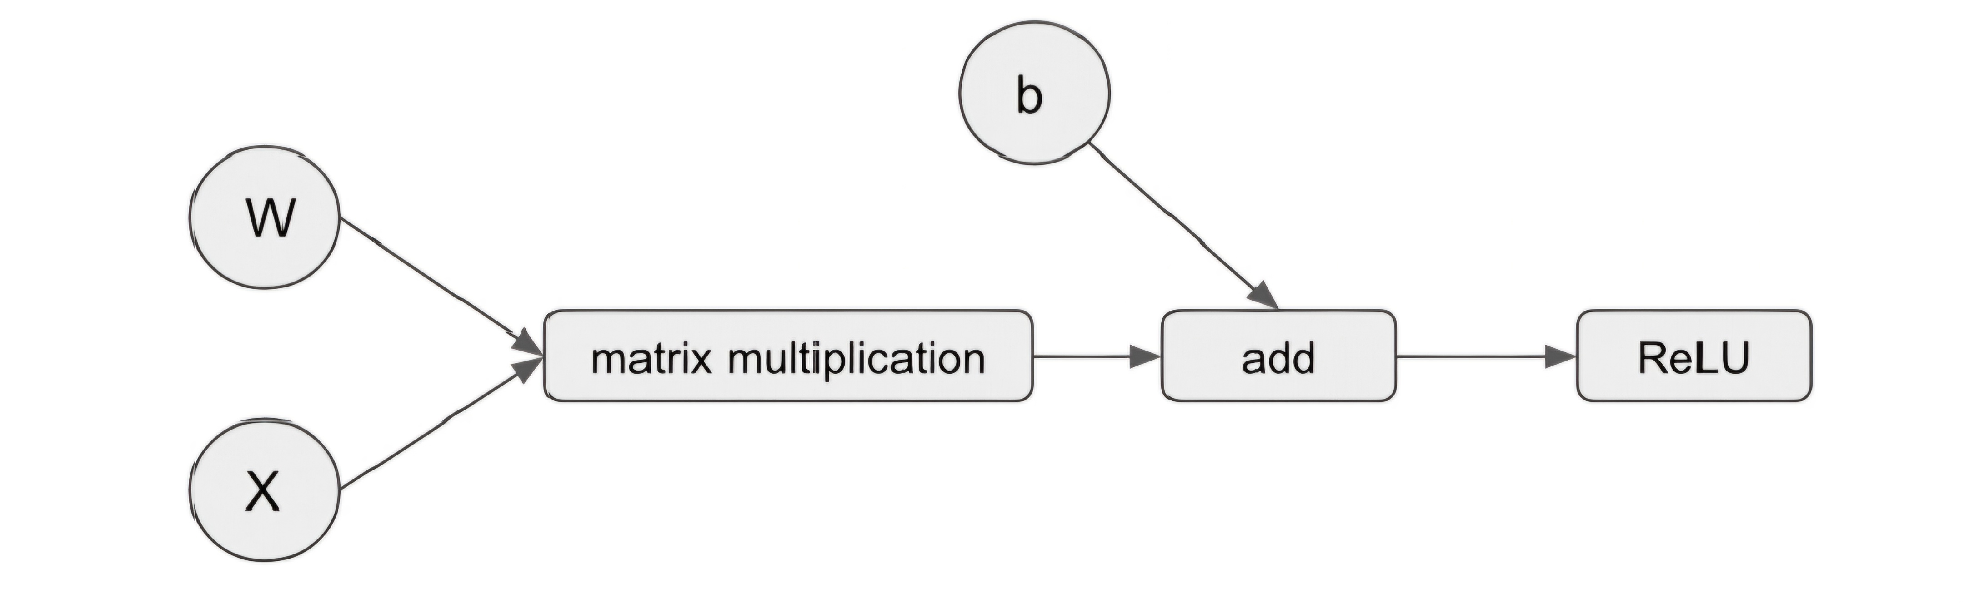
Data flow diagram

Slide 15
Core Components of TensorFlow
TensorFlow provides APIs for defining and training neural networks using Keras.
Includes optimizers, loss functions, and metrics for model training and evaluation.
TensorFlow supports distributed training across multiple GPUs or TPUs for scalability.
Provides TensorFlow Serving for deploying models as RESTful APIs.
TensorFlow Serving provides a scalable solution for deploying models as RESTful APIs, streamlining model inference in production.
TensorFlow's computational graph architecture optimizes large-scale model training by distributing workloads across GPUs or TPUs.

Slide 16
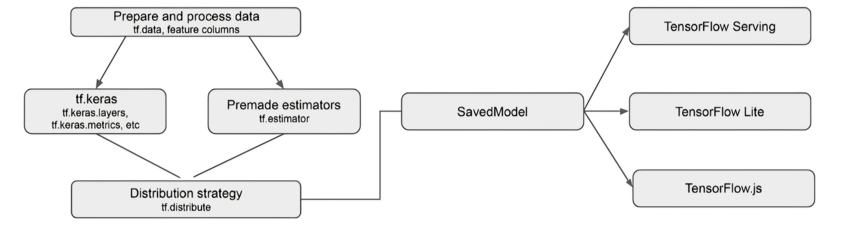
TensorFlow components

Slide 17
Understanding PyTorch ML Library
PyTorch is a popular open-source deep learning library, widely adopted for its ease of use.
It supports dynamic computational graphs, making it flexible for research and experimentation.
Used extensively for tasks like computer vision and natural language processing.
PyTorch integrates well with the Python ecosystem, allowing easy data manipulation.
PyTorch’s dynamic computational graphs allow for greater flexibility, making it a favorite in research and experimental settings.
PyTorch integrates seamlessly with Python, supporting easy data manipulation and conversion between NumPy arrays and tensors.

Slide 18
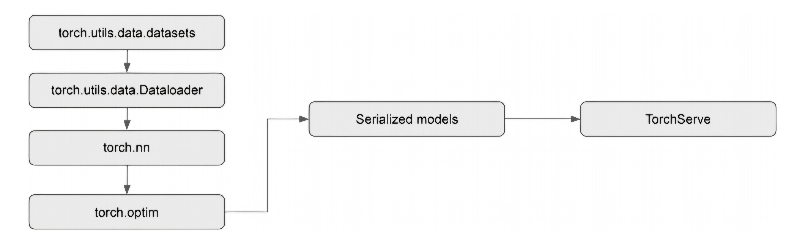
Core components of PyTorch

Slide 19
Core Components of PyTorch
PyTorch uses tensors for data storage and operations, similar to NumPy arrays.
Supports automatic gradient calculation with the Autograd module for backpropagation.
Includes optimizers like SGD and Adam, and evaluation metrics for model performance.
PyTorch supports saving models in serialized formats like pickle (.pth or .pt).
PyTorch’s Autograd module simplifies the gradient calculation process, which is critical for backpropagation in neural networks.
PyTorch’s torch.optim package provides a variety of optimizers, including Adam and SGD, for fine-tuning model performance.

Slide 20
Choosing Between TensorFlow and PyTorch
TensorFlow is ideal for large-scale production and supports distributed training.
PyTorch is favored for its ease of use and flexibility in research settings.
Both libraries support automatic differentiation and provide similar APIs for neural network layers.
The choice depends on the specific project requirements and the team’s familiarity with the library.

Slide 21
Conclusion
Open-source ML libraries are essential tools for building scalable, effective ML solutions.
scikit-learn is best suited for traditional ML tasks, while Spark ML handles distributed data processing.
TensorFlow and PyTorch are popular choices for deep learning, with TensorFlow being better for production and PyTorch for research.
Understanding the core features and components of these libraries helps in selecting the right tool for ML projects.

